Slide 1
The need for Big Data
Let’s look at some examples.
Facebook currently stores 300 petabytes of data
Facebook processes approximately 600 terabytes of data per day
Facebook handles one billion users per day
Facebook processes 2.7 billion ‘Likes’ per day.
300 million photographs uploaded every day.
Notes:
<number>

Slide 2
The need for Big Data
The United States National Security Agency (NSA)
The NSA currently stores approximately five exabytes of data
The NSA processes approximately 30 petabytes of data per day
The NSA touches approximately 1.6 percent of all internet traffic per day (More than Google).
Data such as web searches, phone calls, credit card transactions, health information is stored and analyzed.
Notes:
<number>

Slide 3
The need for Big Data
Google.
Google processes 100 petabytes of information per day
Google indexes 60 trillion web pages per day
Google has greater than one billion unique searches per month
Google processes 2.3 million searches per second.
Notes:
<number>

Slide 4
The need for Big Data
No single hardware platform can handle data sets this large.
Notes:
<number>

Slide 5
Big Data Requirements
To process this volume of data you need three things.
The ability to store massive quantities of data
The ability to extract and process elements of this data in a timely fashion.
The ability for the system to scale as the volumes of data increase.
Notes:
<number>

Slide 6
Examples of scalability requirements
LinkedIn grew from 37 million users in Q1 2009 to 450 million users in Q2 2016.
No single hardware platform can match these scalability requirements, no matter how much memory, CPU and storage is allocated to it.
Notes:
<number>

Slide 7
History of Big Data systems.
Google developed this concept in the early 2000’s after realizing that the web was growing too quickly for existing architectures to process it.
Google created two systems to address this problem.
The Google File System to solve the problem of distributed storage
The MapReduce programming architecture. to solve the problem of distributed processing.
Notes:
<number>

Slide 8
History of Big Data systems.
The Apache foundation took Google’s technologies and developed an open source version.
The Google File System became HDFS
The MapReduce architecture became Hadoop’s Mapreduce
Hadoop is the name for the overall system architecture.
It includes HDFS, MapReduce and YARN.
b
Notes:
<number>

Slide 9
History of Big Data systems.
Hadoop 2.0 released by the Apache Foundation in 2013.
Hadoop 2.0 is a fundamental change in the architecture.
The resource manager YARN was split from the MapReduce system and created as its own subsystem.
b
Notes:
<number>

Slide 10
History of Big Data systems.
Hadoop 2.0 released by the Apache Foundation in 2013.
Hadoop 2.0 is a fundamental change in the architecture.
The resource manager YARN was split from the MapReduce system and created as its own subsystem.
Notes:
<number>

Slide 11
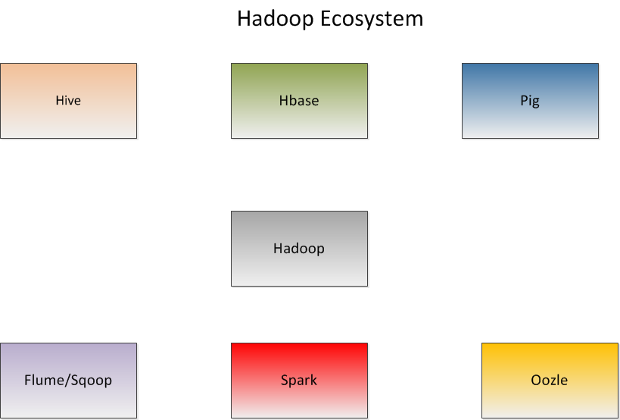
Notes:
<number>

Slide 12
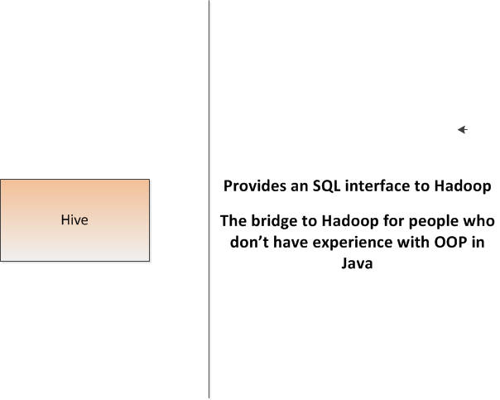
`
Notes:
<number>

Slide 13
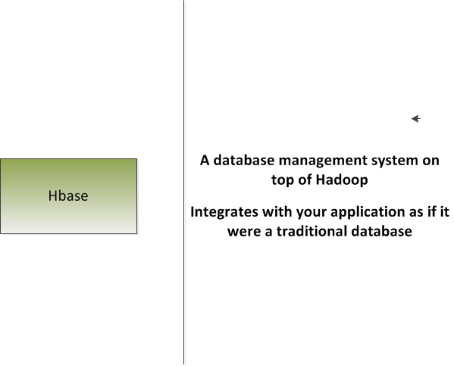
`
Notes:
<number>

Slide 14
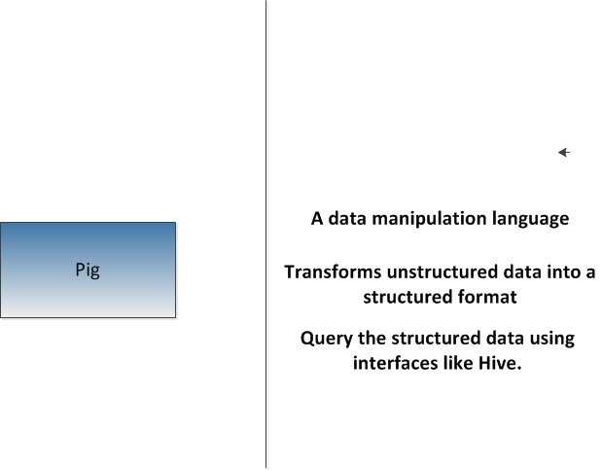
`
Notes:
<number>

Slide 15
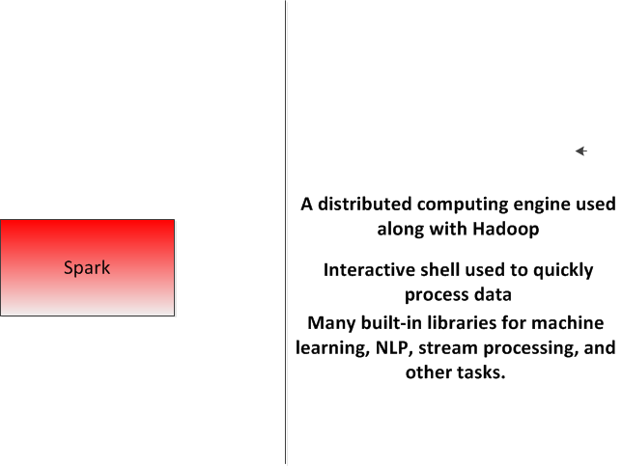
`
Notes:
<number>

Slide 16
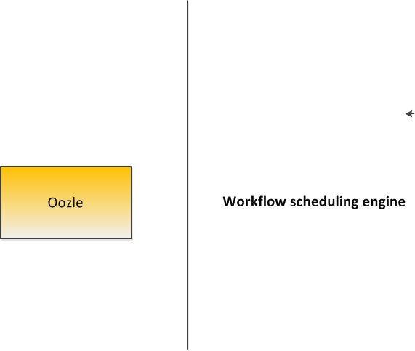
`
Notes:
<number>

Slide 17
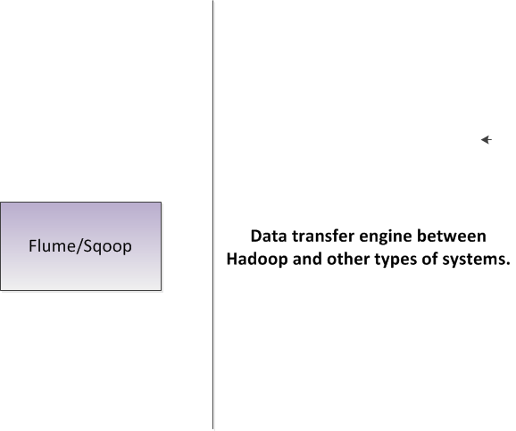
Notes:
<number>

Slide 18
HDFS Design
Each HDFS data node is a simple off-the-shelf system.
HDFS is highly fault tolerant . Hardware failures are assumed.
HDFS is designed for batch processing, HDFS is used for high throughput requirements rather than low latency requirements.
Queries to HDFS are not usually done in real time.
HDFS supports very large data set sizes.
b
Notes:
<number>

Slide 19
HDFS Design
Default block size for Hadoop is 64 Mb.
Default blocksize for the Cloudera distribution is 128 Mb
Files are split among multiple machines and disk storage in a cluster.
One of the machines in a cluster is the master (name) node,
The rest of them are data nodes.
b
Notes:
<number>

Slide 20
HDFS Design
The name node stores the meta data for all files stored in the HDFS.
There is one name node per cluster and possibly a secondary name node.
The name node stores all of the metadata for files.
Consider a file lik e a book. The name node stores the index
The data nodes store the actual pages.
b
Notes:
<number>

Slide 21
HDFS Design
The name node stores the meta data for all files stored in the HDFS.
There is one name node per cluster and possibly a secondary name node.
The name node stores all of the metadata for files.
Consider a file lik e a book. The name node stores the index
The data nodes store the actual pages.
b
Notes:
<number>

Slide 22
HDFS Design
The name node has two primary responsibilities.
First, it manages the HD file system. All requests from a client for data go to the name node first.
The name node stores the file system directory structure and all other metadata about each file.
The data node actually stores the data in blocks on its disk storage devices.
b
Notes:
<number>

Slide 23
HDFS Design
A typical data file is a large text file (size in terabytes or petabytes).
This file is broken up into chunks called blocks.
Each block is stored on a different node in the hadoop cluster.
Each block is the same size.
Differently sized files are treated the same way.
Storage is simplified. We only deal with blocks.
A single unit for fault tolerance and replication.
b
Notes:
<number>

Slide 24
HDFS Design
The default block size in Hadoop is 64 MB (128 MB for Cloudera installations).
Block size is a trade off between parallelism and overhead.
Large block sizes means less processes working. Each process only works on one block
Smaller block sizes means more network and processing overhead.
Optimal blocksize depends on type of data and other considerations.
Notes:
<number>

Slide 25
HDFS Design
The default block size in Hadoop is 64 MB (128 MB for Cloudera installations).
Block size is a trade off between parallelism and overhead.
Large block sizes means less processes working. Each process only works on one block
Smaller block sizes means more network and processing overhead.
Optimal blocksize depends on type of data and other considerations.
Hadoop does its best to run all its tasks on the system that stores the block. This is data locality optimization.
Notes:
<number>

Slide 26
HDFS Design
The default block size in Hadoop is 64 MB (128 MB for Cloudera installations).
Block size is a trade off between parallelism and overhead.
Large block sizes means less processes working. Each process only works on one block
Smaller block sizes means more network and processing overhead.
Optimal blocksize depends on type of data and other considerations.
Hadoop does its best to run all its tasks on the system that stores the block. This is data locality optimization
Notes:
<number>

Slide 27
HDFS Design
Hadoop nodes are generally implemented as commodity hardware.
Commodity hardware can fail.
We have to consider possibility of failure in the name node and data nodes.
Some data in a block may get corrupted.
A data node could crash completely, causing us to lose access to all the data stored.
Notes:
<number>

Slide 28
HDFS Design
Hadoop replicates every file and block stored in the HDFS.
We define a replication factor to decide how data is replicated.
Replication locations are also stored in the name node.
Replication strategy needs to optimize two variables
First, the redundancy factor. A higher redundancy factor means more security.
Second, the write bandwidth. A higher redundancy factor also means a higher write time.
Notes:
<number>

Slide 29
HDFS Design
Nodes on different racks are further away than nodes on the same rack.
A cluster of machines is made up of systems stored on different racks in a system room.
Read/write bandwidth for inter rack nodes are lower than for intra rack nodes.
Replication strategy is defined in hdfs-site.xml configuration file.
Notes:
<number>

Slide 30
HDFS Design
Hadoop then chooses another rack in a different location and writes the second replica to it.
The third replica is on the new rack (but on a different node) as well,
Replication strategy is defined in hdfs-site.xml configuration file.
Notes:
<number>

Slide 31
HDFS Design
A cluster of machines is made up of systems stored on different racks in a system room.
Nodes on different racks are further away than nodes on the same rack.
Read/write bandwidth for inter rack nodes are lower than for intra rack nodes.
The default replication strategy is to replicate data on one node as close to the same rack as possible.
Notes:
<number>

Slide 32
HDFS Design
Hadoop then chooses another rack in a different location and writes the second replica to it.
The third replica is on the new rack (but on a different node) as well,
Replication strategy is defined in hdfs-site.xml configuration file.
Notes:
<number>

Slide 33
HDFS Design
Fault tolerance planning must also take into consideration failure of the name node.
Name node failure means that all of the data in the cluster is permanently lost.
With name node failure, all file/block mapping is gone.
Two specific strategies for overcoming name node failure.
First is the metadata files.
Second is the secondary name node.
Notes:
<number>

Slide 34
HDFS Design
Two metadata files associated with the name node.
First is the fsimage File system image.
Second is the edit log.
Notes:
<number>

Slide 35
HDFS Design
The fsimage file holds a snapshot of the hadoop cluster's file system on startup.
It contains the image of the file system before any writes have been performed.
FSImage is loaded into memory on startup.
Notes:
<number>

Slide 36
HDFS Design
The edit log contains a log of all modifications to files in the cluster's file system since startup.
Putting together the fsimage and the edit log can reconstruct the data in the hdfs cluster.
Both files are by default saved to a local file system directory on the name node.
Alternatively (or simultaneously) this data can be saved to a remote location over the network.
Merging these two files can be computationally intensive.
Notes:
<number>

Slide 37
HDFS Design
The secondary name node contains a replica of the fsimage and edit log from the master.
The secondary namenode merges the files together according to a specifically defined checkpoint.
The newly merged fsimage is then copied back to the primary name node.
The edits log on both nodes is than reset.
Notes:
<number>

Slide 38
HDFS Design
Two ways to define checkpointing.
First is to checkpoint after a specific amount of time.
Second is to checkpoint after a specific number of transactions are completed.
The newly merged fsimage is then copied back to the primary name node.
The edits log on both nodes is than reset.
Notes:
<number>

Slide 39
HDFS Read and Write Operations
To write a file in HDFS, a client needs to interact with the namenode master.
The HDFS clietn sends a create() request on the DistributedFileSystem API.
The API makes a Remote Procedure Call (RPC) to the namenode to create a new file in the namespace.
The namenode performs various checks to make sure that the file doesn’t already exist and that the client has valid create permissions.
The namenode makes a record of the file if all checks pass.
Otherwise, the namenode throws an IOException.
Notes:
<number>

Slide 40
HDFS Read and Write Operations
The API returns an DFSDataOutputStream object for the client to start writing data to.
DFSOutputStream splits the client data into packets and writes it to an internal queue called the data queue.
The data queue is consumed by the DataStreamer object which is responsible for asking the namenode to allocate new blocks.
The list of datanodes form a pipeline.
The DataStreamer streams the packets to the first datanode in the pipeline.
Notes:
<number>

Slide 41
HDFS Read and Write Operations
The first datanode stores the packet and then forwards it to the next datanode in the pipeline.
Similarly, the second datanode stores the packet and forwards it to the third datanode in the pipeline.
And so on until all datanodes in the pipeline have received and stored the packet.
Once the client has finished writing data, the close()method is called on the stream object.
The close flushes all remaining packets to the pipeline and waits for an acknowledgement.
After acknowledgement, the client signals to the namenode that the file is complete.
Notes:
<number>

Slide 42
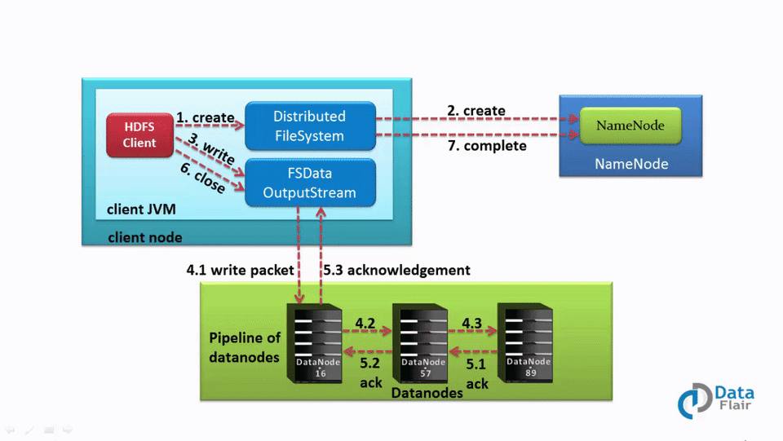
HDFS Read and Write Operations
Notes:
<number>

Slide 43
HDFS Read and Write Operations
To read a file from HDFS, a client needs to interact with the master namenode.
The namenode verifies the clients access privileges.
If checks pass, then the master returns the address of the slaves where the file is stored.
The client then interacts directly with the respective datanodes to read the data.
Notes:
<number>

Slide 44
HDFS Read and Write Operations
The client starts by opening the file using the open() methodon the FileSystem object, which is an instance of the DistributedFileSystem class.
The DistributedFileSystem makes an RPC call to determine the location of the blocks for the first few blocks in the file.
For each block, the namenode returns the addresses of the relevant datanodes. The addresses are sorted by proxmity to the client.
Notes:
<number>

Slide 45
HDFS Read and Write Operations
The DistributedFileSystem returns an FSDataInputStream object to the client.
FSDataInputStream wraps the DFSInputStream object.
DFSInputStream manages the namenode and datanode I/O.
The client calls the read() method on the stream.
DFSInputStream connects the client to the closest dastanode for the first block in the file.
Data is streamed from the datanode back to the client. As a result, the client call call read() repeatedly on the stream.
Notes:
<number>

Slide 46
HDFS Read and Write Operations
If the DFSInputStream encounters an error when communicating with the datanode, it will then try the next closest datanode. It also remembers failed datanodes so that it won’t attempt to retry them for later blocks.
DFSInputStream verifies checksums for the data transferred to it.
Corrupt blocks are reported to the namenode before it attempts to read the block from a different namenode.
Notes:
<number>

Slide 47
HDFS Read and Write Operations
When the client has finished reading the data, it calls a close() method on the stream object.
Notes:
<number>

Slide 48
HDFS Federation
Current HDFS architecture only allows for a single namespace for the entire cluster.
Namespace is managed by a single namenode.
These limitations are addressed by HDFS Federation
Notes:
<number>

Slide 49
HDFS Federation
Namespaces can only be scaled vertically on a single namenode.
This limits the number of blocks, files and directories to the memory resources of the namenode.
Throughput of the cluster are also limited to the namenodes.
Notes:
<number>

Slide 50
HDFS Federation
HDFS Federation uses multiple independent namenodes/namespaces.
The namenodes are federated, in that they are independent of each other.
The datanodes are common storage for all the namenodes.
Each datanode registers with each namenode in the cluster.
Datanodes send periodic heartbeats and block reports and handles commands from the namenodes.
Notes:
<number>

Slide 51
HDFS Federation
A Block Pool is a set of blocks that belong to a single namespace. Datanodes store blocks for all the block pools in the cluster.
It is managed independently of other block pools.
This allows a namespace to generate Block IDs for new blocks without the need for coordination with the other namespaces.
The failure of a namenode does not prevent the datanode from serving other namenodes in the cluster.
Notes:
<number>

Slide 52
HDFS Federation
A Namespace and its block pool together are called Namespace Volume.
It is a self-contained unit of management. When a namenode/namespace is deleted, the corresponding block pool at the datanodes is deleted.
Each namespace volume is upgraded as a unit, during cluster upgrade.
Notes:
<number>

Slide 53
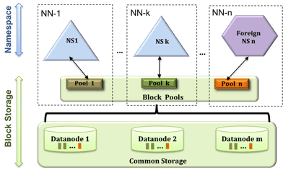
HDFS Federation
Notes:
<number>

Slide 54
HDFS Federation
Key Benefits
Scalability and isolation
Support for multiple namenodes horizontally scales the file system namespace.
It separates namespace volumes for users and categories of applications and improves isolation.
Notes:
<number>

Slide 55
HDFS Federation
Key Benefits
Generic storage service
Block pool abstraction opens up the architecture for future innovation.
New file systems can be built on top of block storage.
New applications can be directly built on the block storage layer without the need to use a file system interface.
New block pool categories are also possible, different from the default block pool.
Notes:
<number>

Slide 56
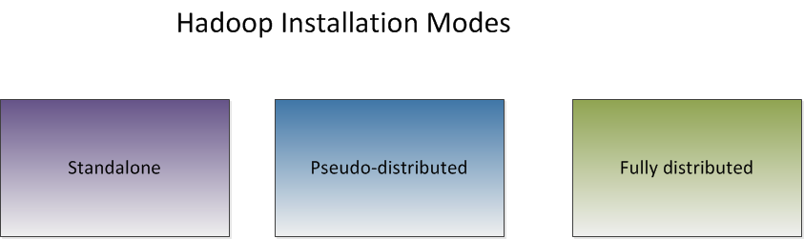
HDFS Installation
Notes:
<number>

Slide 57
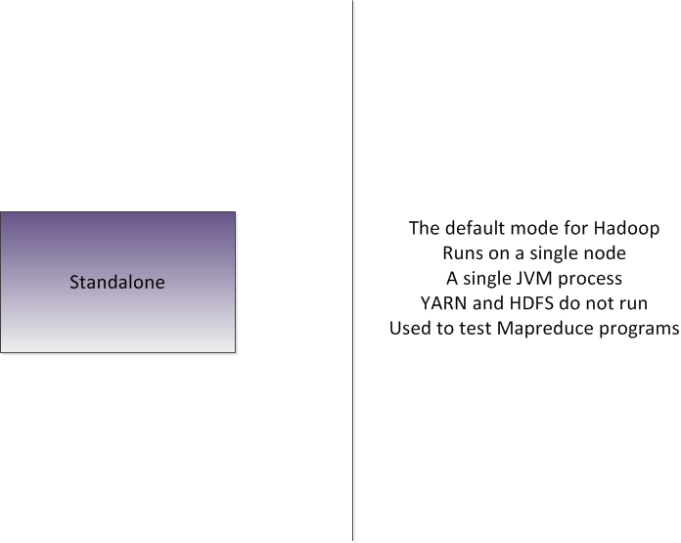
Notes:
<number>

Slide 58
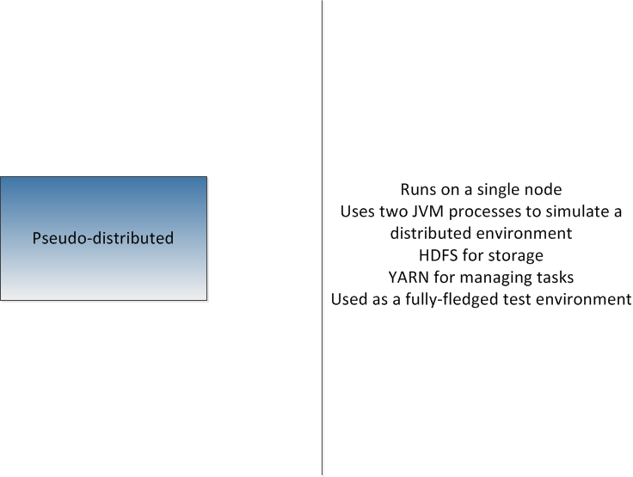
Notes:
<number>

Slide 59
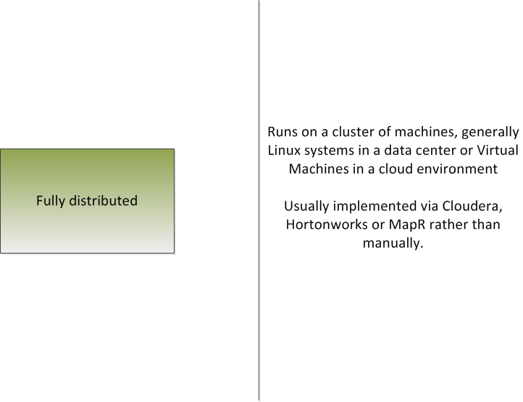
Notes:
<number>

Slide 60
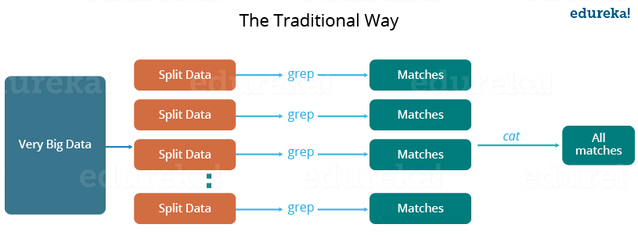
Notes:
<number>

Slide 61
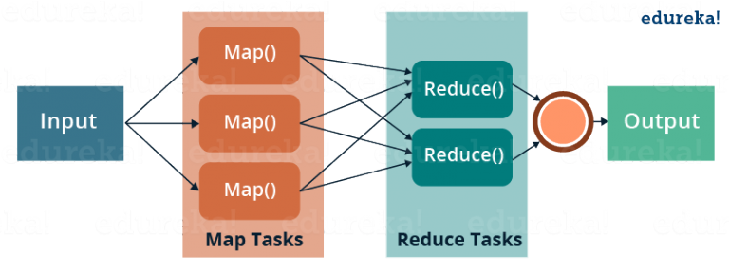
Notes:
<number>

Slide 62
MapReduce
Mapreduce jobs require running processes on many different machines.
Mapreduce is a programming paradigm that allows processing on distributed systems.
Modern systems generate millions of records of raw data.
This data can be many petabytes in size.
These sort of tasks are run in two phases, the map phase and the reduce phase.
Notes:
<number>

Slide 63
MapReduce
The map task divides a job into many different processes, each running on a different compute node.
The reduce task takes the output of the many map tasks and runs some sort of reducing function on it to generate the desired output.
The developer only needs to write a map and reduce function. All of the fault tolerance is handled by hadoop itself.
Map output is in the form of key/value pairs.
The reduce function takes these key/value pairs and runs a reducing function to get the desired output to the client,.
Notes:
<number>

Slide 64
MapReduce
In order to run a mapreduce job on the Hadoop cluster, the job must be compiled into a JAR file.
This jar file is then copied to the designated Hadoop distribution directory for processing.
A Mapreduce input directory needs to be created in the cluster's HDFS.
To actually run a hadoop job, use the hadoop jar command.
Notes:
<number>

Slide 65
Mapreduce
When a job has been submitted, you will see a job id starting with 'job_id<xxxxx>'
Using this job ID, you can monitor the results of the hadoop job .
Hadoop provides a web based resource manager interface .
The default URL is http://localhost:8088.
Notes:
<number>

Slide 66
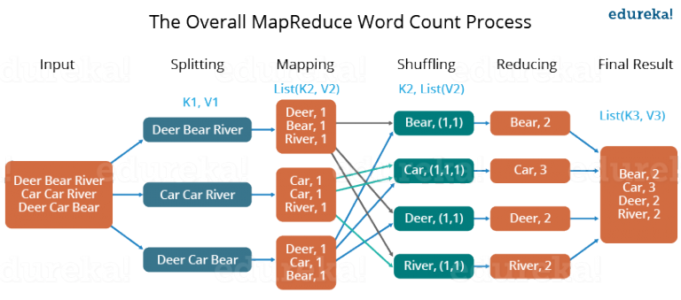
Mapreduce
Notes:
<number>

Slide 67
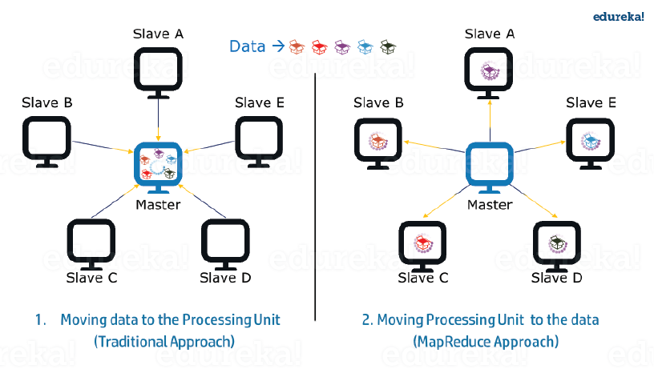
Mapreduce
Notes:
<number>

Slide 68
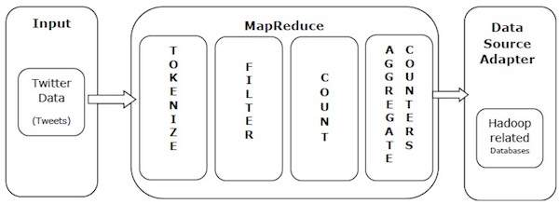
Mapreduce
Example
Notes:
<number>

Slide 69
Mapreduce
Advantages
Parallel Processing.
Data Locality
Notes:
<number>

Slide 70
Mapreduce Optional Functions
Partitioners
Combiners
Notes:
<number>

Slide 71
Mapreduce Optional Functions
A partitioner works like a condition in processing an input dataset. The partition phase takes place after the Map phase and before the Reduce phase.
The number of partitioners is equal to the number of reducers. That means a partitioner will divide the data according to the number of reducers. Therefore, the data passed from a single partitioner is processed by a single Reducer.
Notes:
<number>

Slide 72
Mapreduce Optional Functions
A partitioner partitions the key-value pairs of intermediate Map-outputs.
It partitions the data using a user-defined condition, which works like a hash function.
The total number of partitions is same as the number of Reducer tasks for the job.
For example, if the input data is a list of employees by age and salary and gender, then we can use the partitioner to get maps by gender, i.e. one partition for males and one for females. Each partition is assigned to a reduce job.
Notes:
<number>

Slide 73
Mapreduce Optional Functions
A Combiner, also known as a semi-reducer, is an optional class that operates by accepting the inputs from the Map class and thereafter passing the output key-value pairs to the Reducer class.
The main function of a Combiner is to summarize the map output records with the same key. The output (key-value collection) of the combiner will be sent over the network to the actual Reducer task as input.
Notes:
<number>

Slide 74
Mapreduce Optional Functions
A combiner does not have a predefined interface and it must implement the Reducer interface’s reduce() method.
A combiner operates on each map output key. It must have the same output key-value types as the Reducer class.
A combiner can produce summary information from a large dataset because it replaces the original Map output.
Notes:
<number>

Slide 75
Mapreduce
Example
Tokenize − Tokenizes the tweets into maps of tokens and writes them as key-value pairs.
Filter − Filters unwanted words from the maps of tokens and writes the filtered maps as key-value pairs.
Count − Generates a token counter per word.
Aggregate Counters − Prepares an aggregate of similar counter values into small manageable units.
Notes:
<number>

Slide 76
YARN
YARN stands for Yet Another Resource Negotiator.
In Hadoop Version 1, this was part of the MapReduce framework.
Hadoop Version 2 split the resource management portion into its own subsystem.
Yarn is used by Hadoop to schedule tasks for the cluster.
Notes:
<number>

Slide 77
YARN
YARN coordinates tasks running across the cluster.
YARN keeps track of all tasks and reallocates them in case of a node failure.
YARN consists of two components.
First, the Resource Manager, which runs on a single master node.
Second the Node Manager, which runs on all the nodes.
These managers are implemented as UNIX daemon processes.
Notes:
<number>

Slide 78
YARN
The Resource Manager schedules tasks across all nodes.
The Node manager keeps track of all individual jobs on that specific node.
YARN consists of two components.
First, the Resource Manager, which runs on a single master node.
Second the Node Manager, which runs on all the nodes.
Often, the node manager process is co-located with the data nodes.
Notes:
<number>

Slide 79
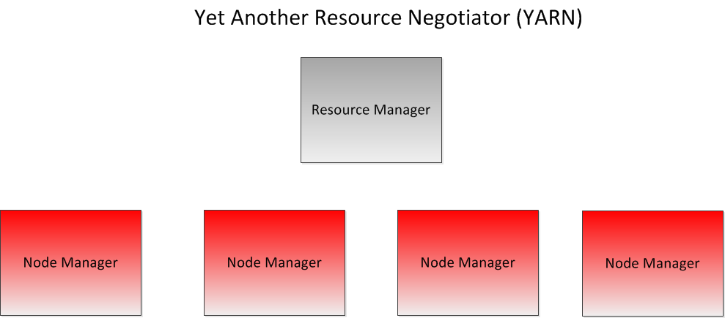
Notes:
<number>

Slide 80
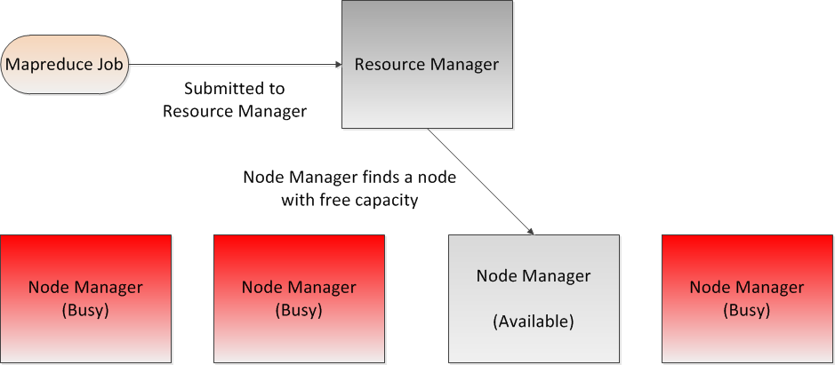
Notes:
<number>

Slide 81
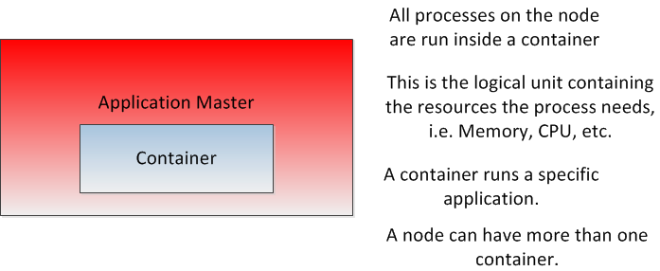
Notes:
<number>

Slide 82
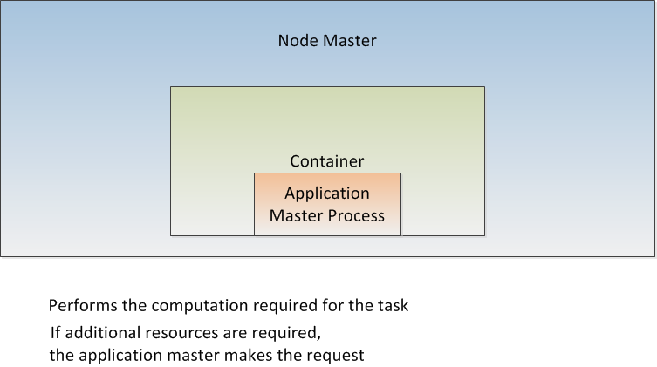
Notes:
<number>

Slide 83
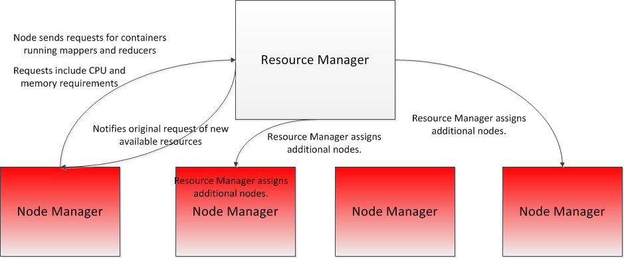
Notes:
<number>

Slide 84
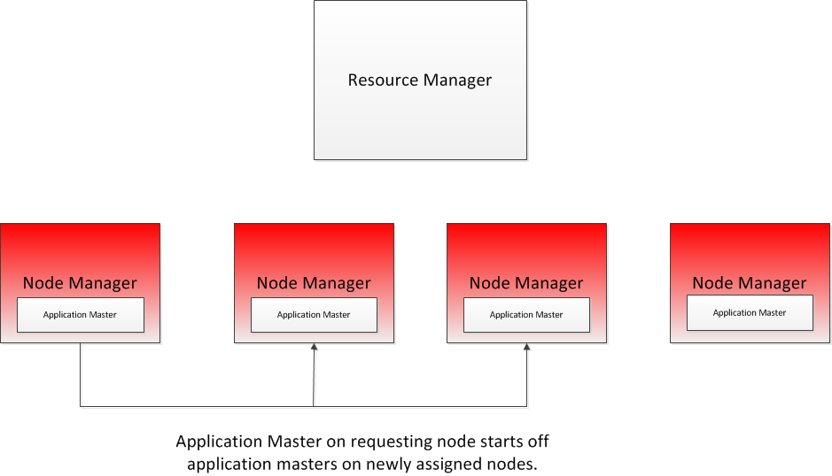
Notes:
<number>

Slide 85
YARN
All processes running in a node are run in a container.
A container is a logical structure.
A container is described by the resources it owns. For example, memory, CPU, storage, etc.
A container runs a specific application assigned to it.
A single node manager can support multiple containers.
Once the container has been created, the Resource manager starts the application process within that container.
Notes:
<number>

Slide 86
YARN
If the application requires more resources to complete its task, it makes a request for more containers via the Node manager to the Resource Manager.
Requests can include CPU or memory.
The Resource Manager scans the cluster looking for compute nodes with the available resources.
If it finds a suitable node, it requests the node manager to create a new container and assigns the extra work to it.
Finally, the original application master making the request is notified of the additional resources.
The application master than starts up new application masters on the newly available nodes.
Notes:
<number>

Slide 87
YARN
Most often, clusters have limited resources, so YARN will have to schedule work according to resource availability.
When scheduling work, several considerations must be taken into account.
First, write bandwidth must be limited.
It is better to assign the map computation close to where the data lives.
If the optimal node is busy, then we wait for the resources to become free.
We do this using scheduling.
Hadoop, by default, uses three types of scheduling algorithms.
Notes:
<number>

Slide 88
YARN
The first type of scheduling is the First In, First Out (FIFO) scheduler.
FIFO scheduling simply means that the first job submitted will take priority.
FIFO scheduling can be inefficient, if Job A is submitted first, and takes significantly more time to complete than Job B, that means that we cannot run Job B first.
FIFO scheduling can results in long wait times for jobs, therefore it is seldom used in practice.
Notes:
<number>

Slide 89
YARN
The next type of scheduling algorithm is the capacity scheduler.
The capacity scheduler implements multiple queues
Each queue is allocated a portion of the cluster's resources.
Jobs can be submitted to specific queues.
Within the queue itself, FIFO scheduling is used.
Note that queues cannot poach each other's allocated resources.
Capacity scheduling allows for parallelization of tasks.
The advantage of capacity scheduling is that small jobs don't get stuck behind larger ones.
The disadvantage is that you may have underutilization of some of the queues.
Notes:
<number>

Slide 90
YARN
The last type of scheduler is the fair scheduler.
In a fair scheduler, resources are always allocated proportionally to each job.
There is no wait time for any job.
The default policy for Hadoop is the capacity scheduler.
The default policy can be set in yarn-policy.xml
Notes:
<number>

Slide 91
Hadoop High Availability
There are two ways to achieve High Availability in the cluster. They are:
Using the Quorum Journal Manager(QJM)
Using the NFS for the shared storage
Notes:
<number>

Slide 92
Hadoop High Availability
In Hadoop 2.0 onwards we have two solutions for HA.
the High Availability feature where we can run redundant NameNodes in the same cluster out of which one will be active and other can be standby. In v2.0 only two redundant nameNodes are supported
Notes:
<number>

Slide 93
Hadoop High Availability
In v3.0 we can now add more than 2 redundant NameNodes.
But only one NameNode can be active at all times.
The active NameNode is responsible for all client operations in the cluster;
the standby nodes are just another worker nodes but they also maintaining enough state information that in case of failure in the Active NameNode they can provide fast failover.
Notes:
<number>

Slide 94
Hadoop High Availability
To maintain this state and keep all the active and standby NameNodes synced, QJM comes into action.
All the NameNodes communicate with a group of separate daemons called Journal Nodes (JNs).
Active node logs all the modification to the majority of Journal Nodes as soon as they are done,
Notes:
<number>

Slide 95
Hadoop High Availability
The the Standby NameNodes are constantly watching Journal Nodes for these modifications. As soon as the modification is logged in the Journal Node, the Standby NameNodes applies these changes to its own namespace.#
The standby NameNodes are now also up to-date in case of any failure.
Notes:
<number>

Slide 96
Hadoop High Availability
another precautionary measure is also taken, in case of failure of active NameNode.
A Secondary Node will read all the logs and will make sure its namespace is up to date before taking the role of Active NameNode.
Notes:
<number>

Slide 97
Hadoop High Availability
In order to deploy an HA cluster, you should prepare the following:
NameNode machines - the machines on which you run the Active and Standby NameNodes should have equivalent hardware to each other, and equivalent hardware to what would be used in a non-HA cluster.
Notes:
<number>

Slide 98
Hadoop High Availability
JournalNode machines - the machines on which you run the JournalNodes. The JournalNode daemon is relatively lightweight, so these daemons may reasonably be collocated on machines with other Hadoop daemons,
for example NameNodes, the JobTracker, or the YARN ResourceManager.
Notes:
<number>

Slide 99
Hadoop High Availability
Note: There must be at least 3 JournalNode daemons, since edit log modifications must be written to a majority of Jns
This will allow the system to tolerate the failure of a single machine.
You may also run more than 3 JournalNodes, but in order to actually increase the number of failures the system can tolerate, you should run an odd number of JNs, (i.e. 3, 5, 7, etc.).
Notes:
<number>

Slide 100
Hadoop High Availability
Note that when running with N JournalNodes, the system can tolerate at most (N - 1) / 2 failures and continue to function normally.
Notes:
<number>

Slide 101
Hadoop High Availability
Similar to Federation configuration, HA configuration is backward compatible and allows existing single NameNode configurations to work without change.
The new configuration is designed such that all the nodes in the cluster may have the same configuration without the need for deploying different configuration files to different machines based on the type of the node.
Notes:
<number>

Slide 102
Hadoop High Availability
Like HDFS Federation, HA clusters reuse the nameservice ID to identify a single HDFS instance that may in fact consist of multiple HA NameNodes.
In addition, a new abstraction called NameNode ID is added with HA. Each distinct NameNode in the cluster has a different NameNode ID to distinguish it.
To support a single configuration file for all of the NameNodes, the relevant configuration parameters are suffixed with the nameservice ID as well as the NameNode ID.
Notes:
<number>

Slide 103
Hadoop High Availability
It is desirable for correctness of the system that only one NameNode be in the Active state at any given time.
Importantly, when using the Quorum Journal Manager, only one NameNode will ever be allowed to write to the JournalNodes, so there is no potential for corrupting the file system metadata from a split-brain scenario.
Notes:
<number>

Slide 104
Hadoop High Availability
However, when a failover occurs, it is still possible that the previous Active NameNode could serve read requests to clients, which may be out of date until that NameNode shuts down when trying to write to the JournalNodes.
For this reason, it is still desirable to configure some fencing methods even when using the Quorum Journal Manager.
Notes:
<number>

Slide 105
Hadoop High Availability
However, to improve the availability of the system in the event the fencing mechanisms fail, it is advisable to configure a fencing method which is guaranteed to return success as the last fencing method in the list. Note that if you choose to use no actual fencing methods, you still must configure something for this setting, for example “shell(/bin/true)”.
Notes:
<number>

Slide 106
Hadoop High Availability
The sshfence option SSHes to the target node and uses fuser to kill the process listening on the service’s TCP port. In order for this fencing option to work, it must be able to SSH to the target node without providing a passphrase.
Notes:
<number>

Slide 107
Hadoop High Availability
shell - run an arbitrary shell command to fence the Active NameNode
The shell fencing method runs an arbitrary shell command.
Notes:
<number>

Slide 108
Hadoop High Availability
shell - run an arbitrary shell command to fence the Active NameNode
The shell fencing method runs an arbitrary shell command.
Notes:
<number>

Slide 109
Hadoop High Availability
After all of the necessary configuration options have been set, you must start the JournalNode daemons on the set of machines where they will run.
This can be done by running the command “hadoop-daemon.sh start journalnode” and waiting for the daemon to start on each of the relevant machines.
Notes:
<number>

Slide 110
Hadoop High Availability
Once the JournalNodes have been started, one must initially synchronize the two HA NameNodes’ on-disk metadata.
If you are setting up a fresh HDFS cluster, you should first run the format command (hdfs namenode -format) on one of NameNodes.
Notes:
<number>

Slide 111
Hadoop High Availability
If you have already formatted the NameNode, or are converting a non-HA-enabled cluster to be HA-enabled, you should now copy over the contents of your NameNode metadata directories to the other, unformatted NameNode by running the command “hdfs namenode -bootstrapStandby” on the unformatted NameNode
Notes:
<number>

Slide 112
Hadoop High Availability
Running this command will also ensure that the JournalNodes (as configured by dfs.namenode.shared.edits.dir) contain sufficient edits transactions to be able to start both NameNodes.
Notes:
<number>

Slide 113
Hadoop High Availability
If you are converting a non-HA NameNode to be HA, you should run the command “hdfs namenode -initializeSharedEdits”, which will initialize the JournalNodes with the edits data from the local NameNode edits directories.
At this point you may start both of your HA NameNodes as you normally would start a NameNode.
Notes:
<number>

Slide 114
Hadoop High Availability
Once your HA NameNodes are configured and started, you will have access to some additional commands to administer thje HA HDFS cluster.
Specifically, you should familiarize yourself with all of the subcommands of the “hdfs haadmin” command. Running this command without any additional arguments will display usage information.
Notes:
<number>

Slide 115
Hadoop High Availability
But we still have a problem.
The above scenario only works if manual intervention is done to move to a secondary name node.
We would really like to have an automatic failover system.
This is where we introduce ZooKeeper.
Notes:
<number>

Slide 116
ZooKeeper
ZooKeeper is a distributed co-ordination service to manage large set of hosts.
Co-ordinating and managing a service in a distributed environment is a complicated process. ZooKeeper solves this issue with its simple architecture and API.
ZooKeeper allows developers to focus on core application logic without worrying about the distributed nature of the application.
Notes:
<number>

Slide 117
ZooKeeper
A distributed application can run on multiple systems in a network at a given time (simultaneously) by coordinating among themselves to complete a particular task in a fast and efficient manner.
Normally, complex and time-consuming tasks, which will take hours to complete by a non-distributed application (running in a single system) can be done in minutes by a distributed application by using computing capabilities of all the system involved.
Notes:
<number>

Slide 118
ZooKeeper
Apache ZooKeeper is a service used by a cluster to coordinate between themselves and maintain shared data with robust synchronization techniques.
ZooKeeper is itself a distributed application providing services for writing a distributed application.
Notes:
<number>

Slide 119
ZooKeeper
The common services provided by ZooKeeper are as follows −
Naming service − Identifying the nodes in a cluster by name. It is similar to DNS, but for nodes.
Configuration management − Latest and up-to-date configuration information of the system for a joining node.
Notes:
<number>

Slide 120
ZooKeeper
Cluster management − Joining / leaving of a node in a cluster and node status at real time.
Leader election − Electing a node as leader for coordination purpose.
Locking and synchronization service − Locking the data while modifying it. This mechanism helps you in automatic fail recovery while connecting other distributed applications like Apache HBase.
Highly reliable data registry − Availability of data even when one or a few nodes are down
Notes:
<number>

Slide 121
ZooKeeper
Distributed applications offer a lot of benefits, but they throw a few complex and hard-to-crack challenges as well.
ZooKeeper framework provides a complete mechanism to overcome all the challenges. Race condition and deadlock are handled using fail-safe synchronization approach.
Another main drawback is inconsistency of data, which ZooKeeper resolves with atomicity.
Notes:
<number>

Slide 122
ZooKeeper
Here are the benefits of using ZooKeeper −
Simple distributed coordination process
Synchronization − Mutual exclusion and co-operation between server processes. This process helps in Apache HBase for configuration management.
Ordered Messages
Notes:
<number>

Slide 123
ZooKeeper
Serialization − Encode the data according to specific rules. Ensure your application runs consistently. This approach can be used in MapReduce to coordinate queues to execute running threads.
Reliability
Atomicity − Data transfer either succeed or fail completely, but no transaction is partial.
Notes:
<number>

Slide 124
ZooKeeper
Cluster management − Joining / leaving of a node in a cluster and node status at real time.
Leader election − Electing a node as leader for coordination purpose.
Notes:
<number>

Slide 125
ZooKeeper
Locking and synchronization service − Locking the data while modifying it. This mechanism helps you in automatic fail recovery while connecting other distributed applications like Apache HBase.
Highly reliable data registry − Availability of data even when one or a few nodes are down
Notes:
<number>

Slide 126
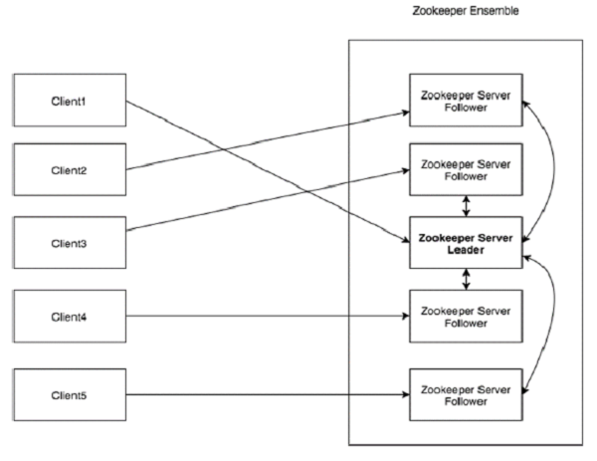
Archictecture of ZooKeeper

Slide 127
ZooKeeper
Clients are one of the nodes in our distributed application cluster, that access information from the server. For a particular time interval, every client sends a message to the server to let the sever know that the client is alive.
Similarly, the server sends an acknowledgement when a client connects. If there is no response from the connected server, the client automatically redirects the message to another server.
Notes:
<number>

Slide 128
ZooKeeper
A Server is one of the nodes in our ZooKeeper ensemble, provides all the services to clients. Gives acknowledgement to client to inform that the server is alive.
An Ensemble is a Group of ZooKeeper servers. The minimum number of nodes that is required to form an ensemble is 3.
Notes:
<number>

Slide 129
ZooKeeper
A Leader is a server node which performs automatic recovery if any of the connected node failed. Leaders are elected on service startup.
A Follower is a server node which follows leader instruction.
Notes:
<number>

Slide 130
ZooKeeper
So, how does ZooKeeper help us with Hadoop cluster management?
Here are some of the things the Hadoop uses ZooKeeper for:
The ZKFailoverController (ZKFC) is a new component which is a ZooKeeper client which also monitors and manages the state of the NameNode. Each of the machines which runs a NameNode also runs a ZKFC
Notes:
<number>

Slide 131
ZooKeeper
The ZKFC is responsible for:
Health monitoring - the ZKFC pings its local NameNode on a periodic basis with a health-check command. So long as the NameNode responds in a timely fashion with a healthy status, the ZKFC considers the node healthy. If the node has crashed, frozen, or otherwise entered an unhealthy state, the health monitor will mark it as unhealthy.
Notes:
<number>

Slide 132
ZooKeeper
The ZKFC is responsible for:
ZooKeeper session management - when the local NameNode is healthy, the ZKFC holds a session open in ZooKeeper. If the local NameNode is active, it also holds a special "lock" znode. This lock uses ZooKeeper's support for "ephemeral" nodes; if the session expires, the lock node will be automatically deleted.
Notes:
<number>

Slide 133
ZooKeeper
The ZKFC is responsible for:
ZooKeeper-based election - if the local NameNode is healthy, and the ZKFC sees that no other node currently holds the lock znode, it will itself try to acquire the lock. If it succeeds, then it has "won the election", and is responsible for running a failover to make its local NameNode active.
Notes:
<number>

Slide 134
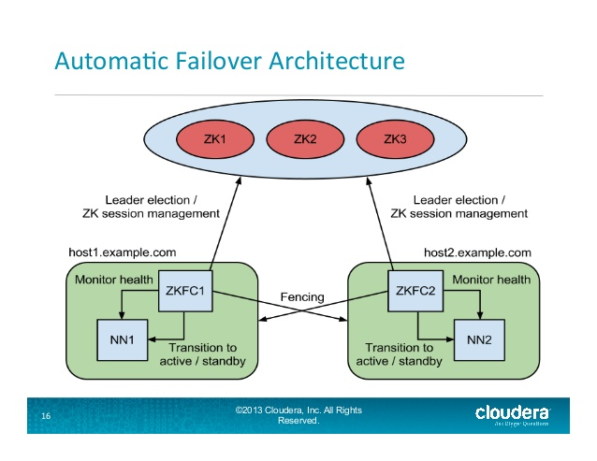
ZooKeeper
Notes:
<number>

Slide 135
ZooKeeper&
In a typical HA cluster, two separate machines are configured as NameNodes.
At any point in time, exactly one of the NameNodes is in an Active state, and the other is in a Standby state.
The Active NameNode is responsible for all client operations in the cluster, while the Standby is simply acting as a slave, maintaining enough state to provide a fast failover if necessary.
r.
Notes:
<number>

Slide 136
ZooKeeper
In order for the Standby Namenode to keep its state synchronized with the Active Namenode, both nodes communicate with a group of separate daemons called JournalNodes (JNs).
When any namespace modification is performed by the Active node, it durably logs a record of the modification to a majority of these JNs. The Standby node is reads these edits from the JNs and apply to its own name space.
In the event of a failover, the Standby will ensure that it has read all of the edits from the JounalNodes before promoting itself to the Active state. This ensures that the namespace state is fully synchronized before a failover occurs.
It is vital for an HA cluster that only one of the NameNodes is Active at a time. ZooKeeper has been used to avoid split brain scenario so that name node state is not getting diverged due to failover.
Notes:
<number>

Slide 137
ZooKeeper
In the event of a failover, the Standby will ensure that it has read all of the edits from the JounalNodes before promoting itself to the Active state. This ensures that the namespace state is fully synchronized before a failover occurs.
It is vital for an HA cluster that only one of the NameNodes is Active at a time. ZooKeeper has been used to avoid split brain scenario so that name node state is not getting diverged due to failover.
Notes:
<number>

Slide 138
Hadoop Monitoring
We need to be able to collect metrics.
Collecting Namenode metrics
Collecting DataNode metrics
Collecting HDFS metrics.
Notes:
<number>

Slide 139
Hadoop Monitoring
The Namenode has an HTTP RESTful API
Usually located at https://<namenode>:50070
You can also browse to http://<namenode>:50070/jmx
Notes:
<number>

Slide 140
Hadoop Monitoring
Each datanode also has an HTTP RESTful API
Usually can be found at:
http://<datanode>:50070/dfshealth.html
#tab-datanode
Also, can use the JMX API to collect data.
The ResourceManager exposes all the MapReduce counters for each job.
Default port for these metrics is at 8088 on the resource manager.
Notes:
<number>

Slide 141
Hadoop Monitoring
Many third party tools are available
Apache Ambari
Cloudera Manager
Both tools are free.
Notes:
<number>

Slide 142
Apache Spark
Apache Spark is a lightning-fast cluster computing designed for fast computation.
It was built on top of Hadoop MapReduce and it extends the MapReduce model to efficiently use more types of computations which includes Interactive Queries and Stream Processing.
Notes:
<number>

Slide 143
Apache Spark
Industries are using Hadoop extensively to analyze their data sets.
The reason is that Hadoop framework is based on a simple programming model (MapReduce) and it enables a computing solution that is scalable, flexible, fault-tolerant and cost effective.
Here, the main concern is to maintain speed in processing large datasets in terms of waiting time between queries and waiting time to run the program.
Notes:
<number>

Slide 144
Apache Spark
Spark was introduced by Apache Software Foundation for speeding up the Hadoop computational computing software process.
Against common belief, Spark is not a modified version of Hadoop and is not, really, dependent on Hadoop because it has its own cluster management. Hadoop is just one of the ways to implement Spark.
Notes:
<number>

Slide 145
Apache Spark
Spark uses Hadoop in two ways – one is storage and second is processing. Since Spark has its own cluster management computation, it uses Hadoop for storage purpose only.
The main feature of Spark is its in-memory cluster computing that increases the processing speed of an application.
Notes:
<number>

Slide 146
Apache Spark
Apache Spark has following features.
Speed − Spark helps to run an application in Hadoop cluster, up to 100 times faster in memory, and 10 times faster when running on disk.
This is possible by reducing number of read/write operations to disk. It stores the intermediate processing data in memory.
Notes:
<number>

Slide 147
Apache Spark
Supports multiple languages − Spark provides built-in APIs in Java, Scala, or Python. Therefore, you can write applications in different languages. Spark comes up with 80 high-level operators for interactive querying.
Advanced Analytics − Spark not only supports ‘Map’ and ‘reduce’. It also supports SQL queries, Streaming data, Machine learning (ML), and Graph algorithms.
Notes:
<number>

Slide 148
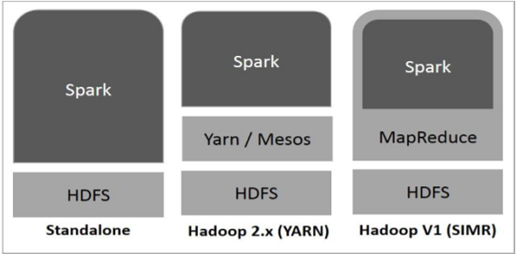
Apache Spark
Notes:
<number>

Slide 149
Apache Spark
There are three ways of Spark deployment as explained below.
Standalone − Spark Standalone deployment means Spark occupies the place on top of HDFS(Hadoop Distributed File System) and space is allocated for HDFS, explicitly. Here, Spark and MapReduce will run side by side to cover all spark jobs on cluster.
Notes:
<number>

Slide 150
Apache Spark
Hadoop Yarn − Hadoop Yarn deployment means, simply, spark runs on Yarn without any pre-installation or root access required. It helps to integrate Spark into Hadoop ecosystem or Hadoop stack. It allows other components to run on top of stack.
Notes:
<number>

Slide 151
Apache Spark
Spark in MapReduce (SIMR) − Spark in MapReduce is used to launch spark job in addition to standalone deployment. With SIMR, user can start Spark and uses its shell without any administrative access.
Notes:
<number>

Slide 152
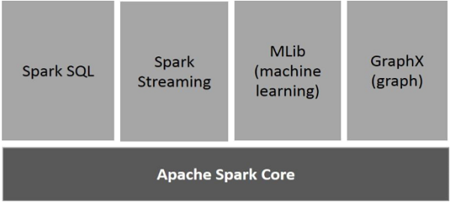
Apache Spark
Notes:
<number>

Slide 153
Apache Spark
Features of Spark include:
Resilient Distributed Datasets (RDD) is a fundamental data structure of Spark. It is an immutable distributed collection of objects. Each dataset in RDD is divided into logical partitions, which may be computed on different nodes of the cluster. RDDs can contain any type of Python, Java, or Scala objects, including user-defined classes.
Notes:
<number>

Slide 154
Apache Spark
Spark makes use of the concept of RDD to achieve faster and efficient MapReduce operations. Let us first discuss how MapReduce operations take place and why they are not so efficient.
Notes:
<number>

Slide 155
Apache Spark
MapReduce is widely adopted for processing and generating large datasets with a parallel, distributed algorithm on a cluster.
It allows users to write parallel computations, using a set of high-level operators, without having to worry about work distribution and fault tolerance.
Notes:
<number>

Slide 156
Apache Spark
Unfortunately, in most current frameworks, the only way to reuse data between computations (Ex − between two MapReduce jobs) is to write it to an external stable storage system (Ex − HDFS).
Although this framework provides numerous abstractions for accessing a cluster’s computational resources, users still want more.
Notes:
<number>

Slide 157
Apache Spark
Both Iterative and Interactive applications require faster data sharing across parallel jobs.
Data sharing is slow in MapReduce due to replication, serialization, and disk IO.
Regarding the storage system, most Hadoop applications spend more than 90% of their time doing HDFS read-write operations.
Notes:
<number>

Slide 158
Apache Pig
Apache Pig is a dataflow language for expressing data analysis and infrastructure processes
Pig uses both HDFS (to do file I/O) and MapReduce (to run jobs)
Pig is extensible through user defined functions that can be written in Java or other languages.
Notes:
<number>

Slide 159
Apache Pig
Pig has three components
The first is the Pig Latin language.
Pig Latin is a high level scripting language
Pig Latin doesn’t need any metadata or schemas
All PigLatin statements translated into a series of MapReduce jobs.
Notes:
<number>

Slide 160
Apache Pig
Pig has three components.
The second component is Grunt.
Grunt is the interactive shell for Pig.
Notes:
<number>

Slide 161
Apache Pig
The Pig Latin language is a language for expressing data analytics and infrastructure processes.
Supports many types of traditional data operations, such as join, sort, filter and others.
Simplifies joining data and chaining jobs together
Notes:
<number>

Slide 162
Apache Pig
Hcatalog can be used with Pig to offload location and metadata information requirements from Pig.
We no longer need Pig scripts to handle the data locations.
The dataflow model with Hcatalog looks like this:
Load (Hcatalog)
Transform (Pig)
Dump or Store (Pig)
Notes:
<number>

Slide 163
Apache Pig
Pig Latin Scripts describe a Directed Acyclic Graph Where the edges are dataflow and the nodes are data operations.
Notes:
<number>

Slide 164
Apache Pig
grunt> LOGS = load ‘sample.log’
grunt> LEVELS = FOREACH LOGS GENERATE (
REGEX_EXTRACT($0,’(INFO|DEBUG|WARN|ERROR|FATAL)’,1) AS LOGLEVELS
grunt> DUMP LOGLEVEL
Notes:
<number>

Slide 165
Apache Pig
The Pig interpreter evaluates each statement.
If the statement is valid, Pig adds it to the ‘Plan’ which is built by the interpreter..
The interpreter will not execute any statements until it finds a DUMP or STORE command.
Notes:
<number>

Slide 166
Apache Pig
Pig uses the concept of a ‘bag’ as its relational structure.
A bag is a collection of unordered tuples.
Each tuple corresponds to a row in a relational table.
Unlike a standard SQL relation, tuples don’t have to have the same data types or sizes
Notes:
<number>

Slide 167
Apache Pig
Pig has three data structures
The first is the bag
The second is the tuple
The third is the map (a collection of key/value pairs).
Notes:
<number>

Slide 168
Apache Pig
logevents = LOAD ‘input/mylog’ AS (date:chararray, level:chararray,code:int, message:chararray)
Severe = FILTER logevents BY (level = ‘severe’ and code >=500
Grouped = GROUP severe BY code
STORE grouped INTO ‘output/severeevents’
Notes:
<number>

Slide 169
Apache Pig
e1 = LOAD ‘pig/input/File1’ USING PigStorage(‘,’) AS (name:chararray,age:int,l
zip:int, salary:double)
f = FOREACH e1 GENERATE age,salary;
DESCRIBE f;
DUMP f;
Notes:
<number>

Slide 170
Apache Pig
Employees = LOAD ;pig/input/File1’ USING PigStorage(‘,’)
AS(name:chararray,age:int, zip:int, salary:double);
sorted = ORDER employees by Salary;
Employees = LOAD ‘pig/input/File1’ USING PigStorage(‘,’)
AS (name:charray, age:int, zip:int, salary:double);
Agegroup = GROUP employees by age;
li = LIMIT agegroup 100;
Notes:
<number>

Slide 171
Apache Pig
e1 = LOAD ‘pig/input/File1’ USING PigStorage(‘,’)
AS (name:chararray,age:int,zip:int,salary:double)
e2 = LOAD ‘pig/input/File2’ USING PigStorage(‘,’)
AS (name:chararray, phone:chararray);
e3 = JOIN e1 by name, e2 by name
DESCRIBE e3;
DUMP e3;
Notes:
<number>

Slide 172
Apache Pig
We can use illustrate, explain, and describe to help us debug pig latin scripts
Suggest using local mode to test the script before running it on the cluster
Local node is slow, but there is no waiting for a slot for the job to run
Logs for local mode appear on your screen instead of on the remote task node.
Local mode runs all in your local process so you can attach a debugger to it.
Notes:
<number>

Slide 173
Apache Hive
Hive is a data warehouse layer build on top of Hadoop
Allows you define a structure for your unstructured Big Data
Simplifies analysis and queries with an SQL like language called HiveSQL
Notes:
<number>

Slide 174
Apache Hive
Hive is not a relational database
Hive uses a database to store metadata but all data that Hive processes is stored in the HDFS.
Hive is not designed for OLTP
Hive runs on Hadoop (a batch processing system)
Hive latency is generally high
Hive is not suited for real-time queries and row-level updates.
Notes:
<number>

Slide 175
Apache Hive
Hive takes multi structured data and gives back a view and a structure which can make sense to a business analyst.
Hive supports uses such as
Ad-hoc queries
Summarization
Data analysis
Notes:
<number>

Slide 176
Apache Hive
The Hive architecture includes :
The Hive command line interface
The Metastore, which stores schema information and provides structure to stored data
The Hive QL, which supports query processing, compiling and optimizing
Notes:
<number>

Slide 177
Apache Hive
Hive is a good choice when you want to query the data
When you need an answer to a specific question
If you are already familiar with SQL
Pig is a good choice when you want to perform Extract , Transform and Load (ETL)
When you want to prepare data for easier analysis
When you have a long series of steps to do.
Notes:
<number>

Slide 178
Apache Hive
The HiveQL is similar to other SQLs
It uses standard relational database concepts such as tables, rows, columns and schema)
Supports multi-table insert via your code. It accesses ‘Big Data’ via tables
Converts SQL queries into MapReduce jobs
Also supports plugging custom MapReduce scripts into queries
Notes:
<number>

Slide 179
Apache Hive
A Hive table consists of:
Data: typically a file or group of files stored on the HDFS.
Schema: in the form of metadata stored in a relational database
Schema and data are separate
A schema can be defined for existing data
Data can be added or removed independently.
Hive can be pointed at existing data.
You must have a schema defined if you want to point Hive to existing data. In the HDFS.
Notes:
<number>

Slide 180
Apache Hive
Hive> CREATE TABLE mytable (name string, age int)
ROW FORMAT DELIMITED
FIELDS TERMINATED BY ‘;’
STORED AS TEXTFILE;
Notes:
<number>

Slide 181
Apache Hive
Hive> LOAD DATA LOCAL INPATH
‘/tmp/customers.csv’ OVERWRITE INTO TABLE customers;
Hive> LOAD DATA INPATH
‘user/train/customers.csv’ OVERWRITE INTO TABLE customers
INSERT INTO birthdays SELECT firstName, lastName, birthday FROM
customers where birthday IS NOT NULL;
Notes:
<number>

